Slide 1
Demonstrate detection of cars, pedestrians, traffic signs, and other obstacles using YOLO v8 based model.
Essentials of Deep Learning
24MAS10013 Ansuman Pujari
24MAS10015 Jayesh Zope
24MAS10016 Sayan Ghorai
24MAS10026 Mallari Madhu
24MAS10038 Vaibhav Mandavkar
24MAS10050 Harshvardhan Yadav

Slide 2
Introduction to YOLO v8 for Object Detection
YOLO v8 (You Only Look Once) is a state-of-the-art deep learning model for real-time object detection. It balances speed and accuracy, making it ideal for applications like autonomous driving, surveillance, and robotics.
Key Features:
High-speed detection: Processes images in real time.
Multi-object detection: Identifies cars, pedestrians, traffic signs, and obstacles.
Compact and efficient: Optimized for edge devices and real-world applications.

Slide 3
Berkeley DeepDrive (BDD100K) Dataset
The BDD100K dataset is one of the largest and most diverse datasets for autonomous driving. It contains 100,000 driving videos and annotated images collected from various environments, including highways, urban streets, and rural roads.
Why BDD100K for YOLO v8 Training?
Diverse Data: Covers different weather conditions, lighting, and traffic scenarios.
Rich Annotations: Includes labels for cars, pedestrians, traffic signs, signals, and obstacles.
Real-World Relevance: Helps train YOLO v8 for accurate object detection in real driving conditions.
High-Quality Bounding Boxes: Ensures precise localization of objects.

Slide 4
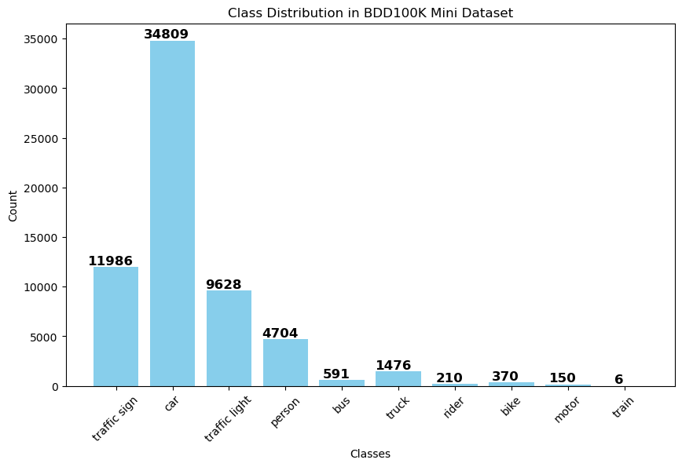
We are using a small subset of BDD100k Data : image count 3458

Slide 5
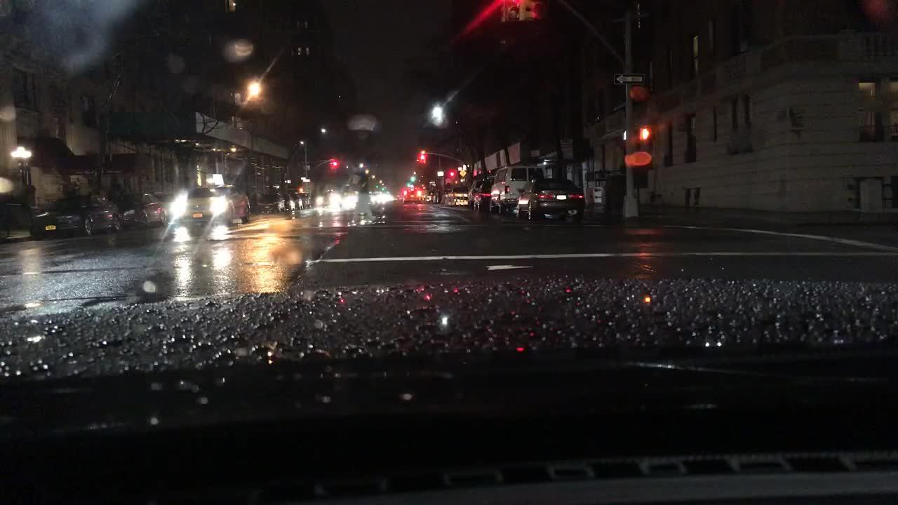
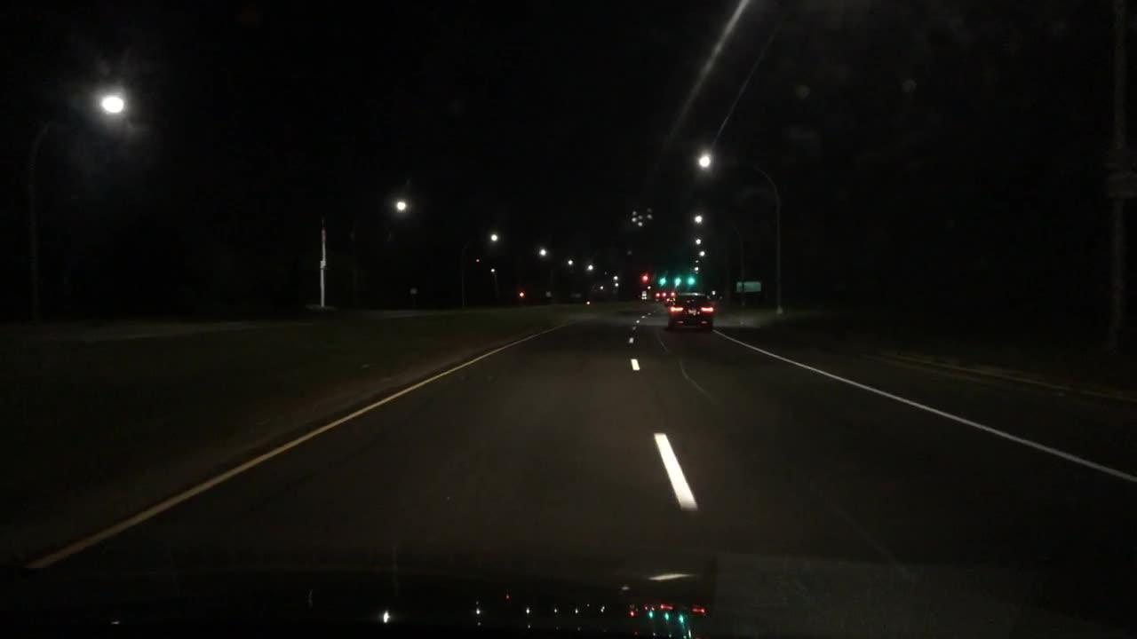
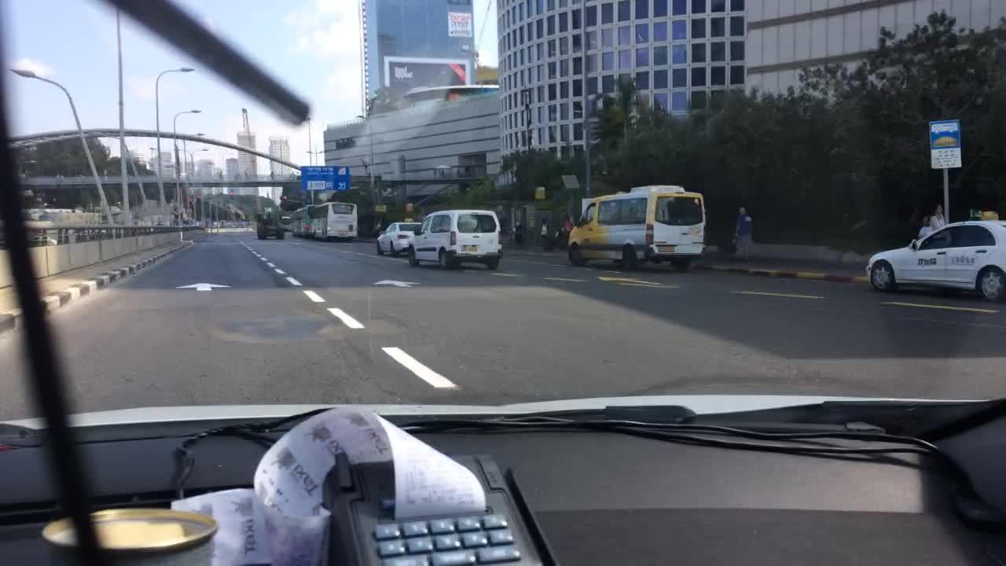
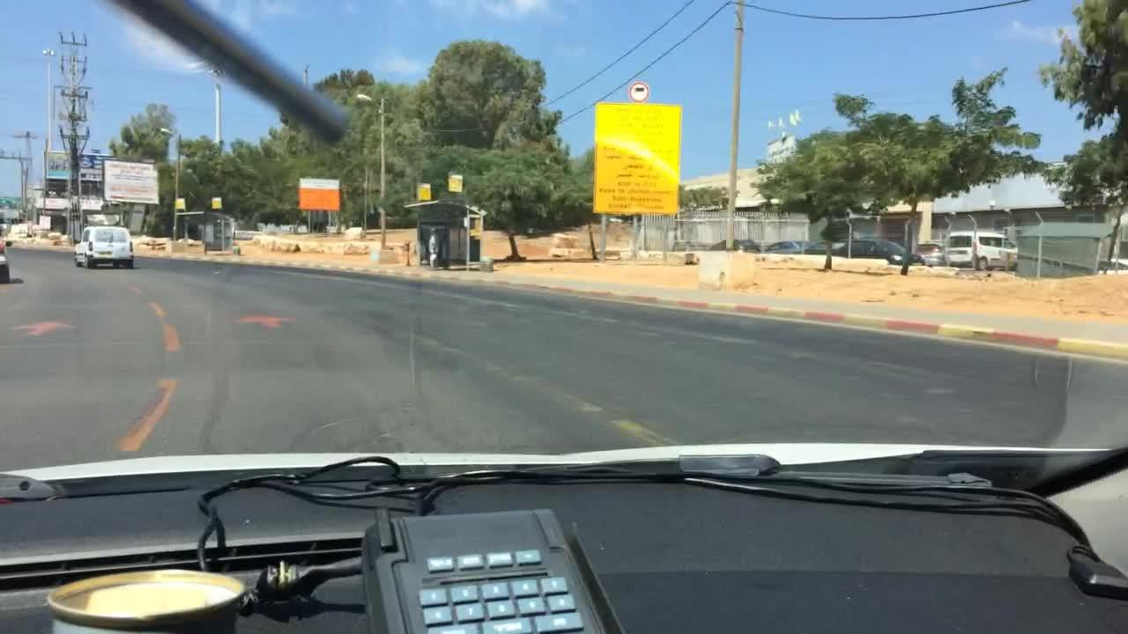
Sample images

Slide 6
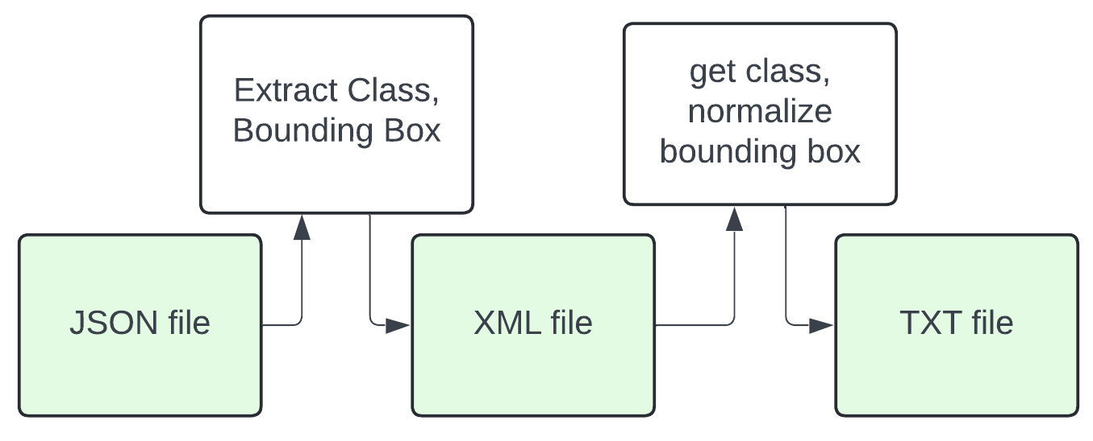
Preprocessing
We are processing Labels from original dataset as they are in json format while YOLO takes labels in txt format
For error proof conversion we are converting json to xml before converting it to txt format
The conversion pipeline look like this

Slide 7
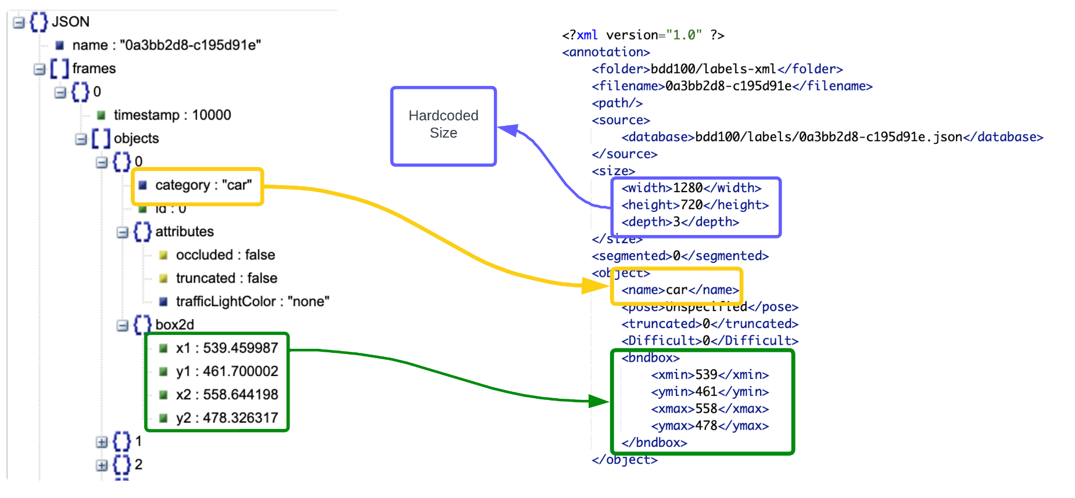
JSON to XML

Slide 8
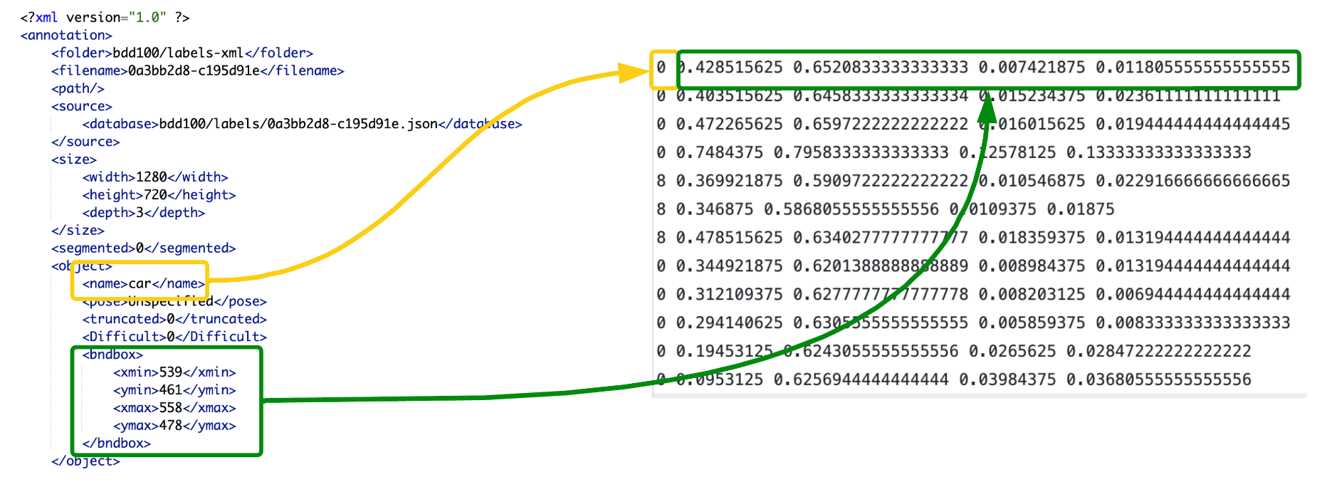
XML to TXT

Slide 9
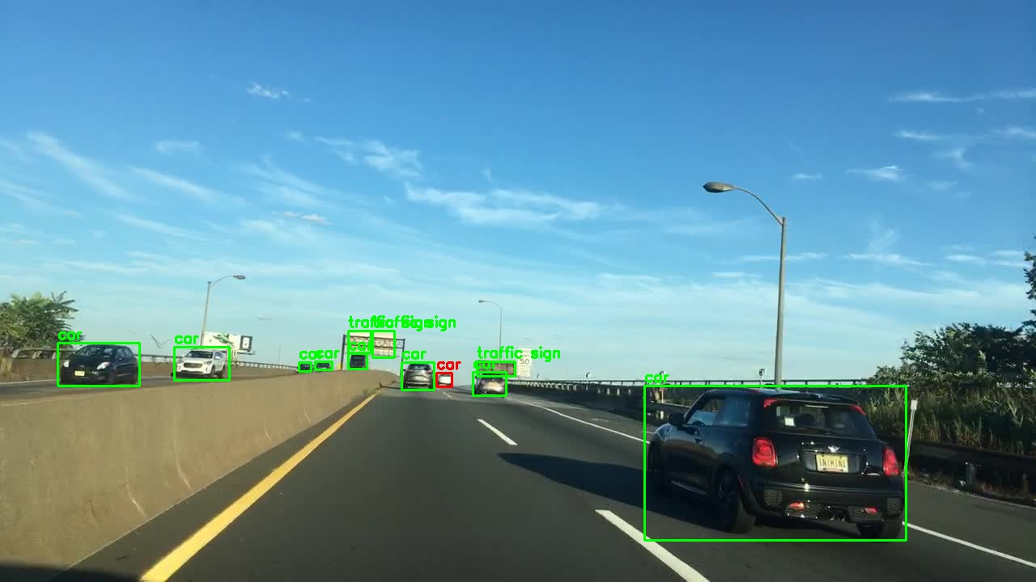
Labeled Image with bounding box

Slide 10
Sample yolo formatted label file
0 0.490234375 0.32916666666666666 0.012109375 0.022222222222222223
0 0.703515625 0.31527777777777777 0.044140625 0.04027777777777778
0 0.778125 0.39166666666666666 0.1265625 0.10694444444444444
0 0.25078125 0.38125 0.25078125 0.3784722222222222
0 0.933984375 0.4361111111111111 0.065234375 0.1361111111111111
8 0.724609375 0.20416666666666666 0.019921875 0.043055555555555555
8 0.515625 0.22361111111111112 0.0171875 0.013888888888888888
We have class 0 : cars and class 8 : traffic signs with its bounding box co-ordinates

Slide 11
Model Training
model = YOLO('yolov8n.pt') # Select specific YOLO model ‘n’ is for nano
results = model.train(
data='mydata.yml', #pass .yml which should contain train and val path and classes
imgsz=640,
epochs=10,
batch=32,
name='yolov8n_custom',
)

Slide 12
Metric | YOLOv8m | YOLOv8s | YOLOv8n
Precision | 0.553 | 0.33 | 0.225
Recall | 0.298 | 0.24 | 0.198
mAP50 | 0.302 | 0.23 | 0.185
Validation Loss | 2.4 | 3.6 | 4.1
Model Size (MB) | ~83 | ~35 | ~7
Inference Speed (ms/img) | ~8.2 | ~6.5 | ~3.8
For accuracy-related metrics (Precision, Recall, mAP50, Loss): YOLOv8m wins across the board.
For efficiency (Model size and speed): YOLOv8n dominates with the smallest size and fastest inference.

Slide 13
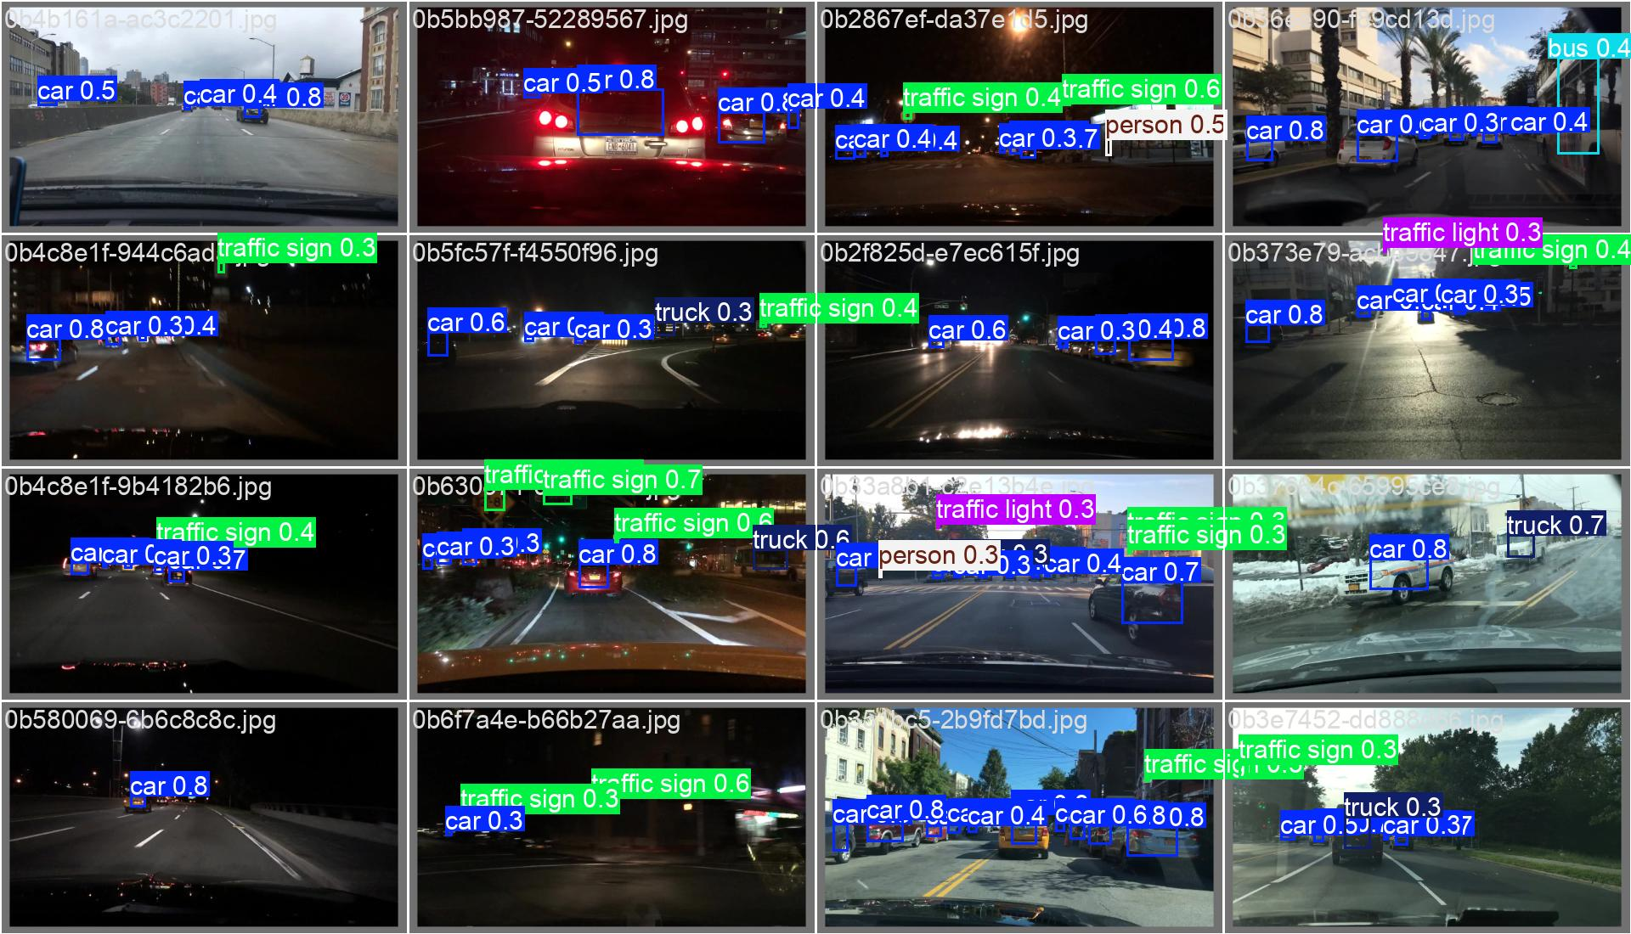
Results and Visualization

Slide 14
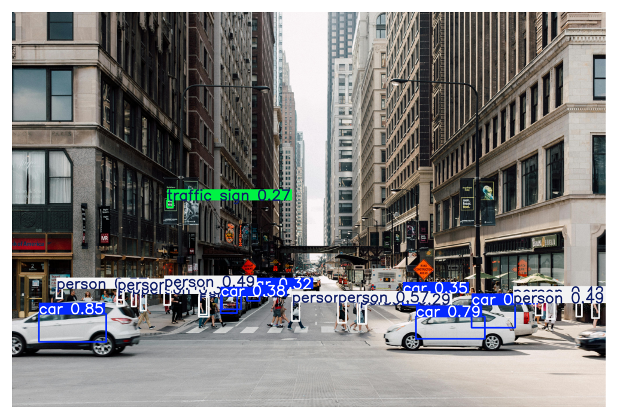
Sample validated image

Slide 15
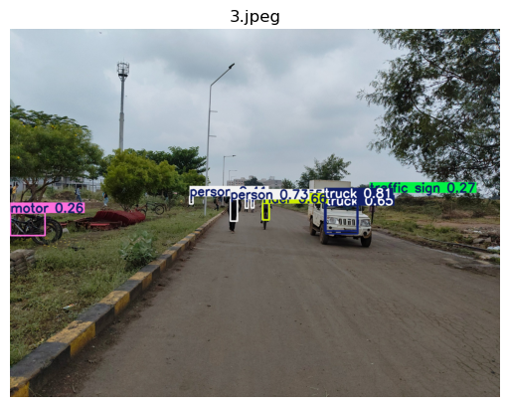
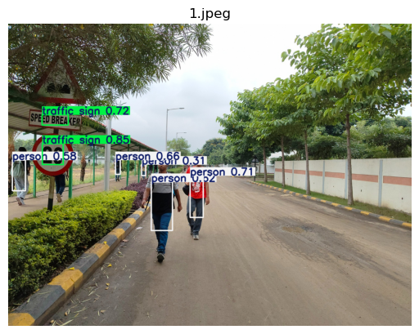
Sample validated images

Slide 16
Thank You

